Slide 1
Introduction to Big Data & Basic Data Analysis By: Prof. Prakash Patel IT,Dept. GIT

Slide 2
What’s Big Data?
‘Big-data’ is similar to ‘Small-data’, but bigger
Big data is the term for a collection of data sets so large and complex that it becomes difficult to process using on-hand database management tools or traditional data processing applications.
The Data which doesn't fit in storage as well as processing capacity then its BigData.

Slide 3
Why Big Data?
Key enablers for the growth of “Big Data” are:
Increase of storage capacities
Increase of processing power
Availability of data

Slide 4
Challenges to Big Data.
Capture
Storage
Search
Sharing
Transfer
Analysis
Visualization

Slide 5
Benefits of Big Data
Using the information kept in the social network like Facebook, the marketing agencies are learning about the response for their campaigns, promotions, and other advertising mediums.
Using the information in the social media like preferences and product perception of their consumers, product companies and retail organizations are planning their production.
Using the data regarding the previous medical history of patients, hospitals are providing better and quick service.

Slide 6

Big Data EveryWhere!
Lots of data is being collected and warehoused
Web data, e-commerce
purchases at department/ grocery stores
Bank/Credit Card transactions
Social Network

Slide 7
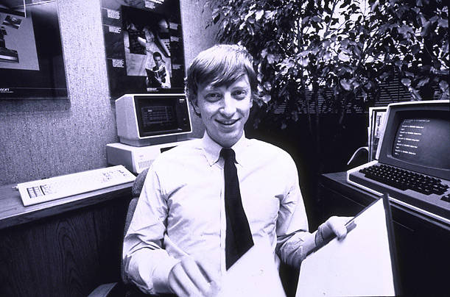
How much data?
Google processes 20 PB(10¹⁵ bytes) a day (2008)
Wayback Machine has 3 PB + 100 TB/month (3/2009)
Facebook has 2.5 PB of user data + 15 TB/day (4/2009)
eBay has 6.5 PB of user data + 50 TB/day (5/2009)
CERN’s Large Hydron Collider (LHC) generates 15 PB a year
640K ought to be enough for anybody.

Slide 8
Type of Data
Relational Data (Tables/Transaction/Legacy Data)
Text Data (Web)
Semi-structured Data (XML)
Graph Data
Social Network, Semantic Web
Streaming Data
You can only scan the data once

Slide 9
What to do with these data?
Aggregation and Statistics
Data warehouse and OLAP(Online Analytical Processing)
Indexing, Searching, and Querying
Keyword based search
Pattern matching
(XML(Extensible Markup Language)
RDF(Resource Description Framework))
Knowledge discovery
Data Mining
Statistical Modeling

Slide 10
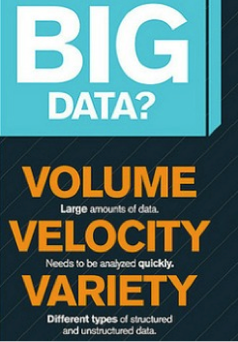

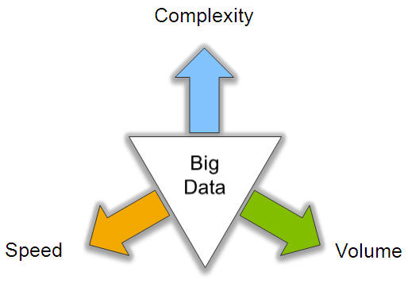
Big Data: 3V’s

Slide 11
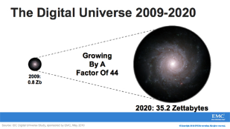
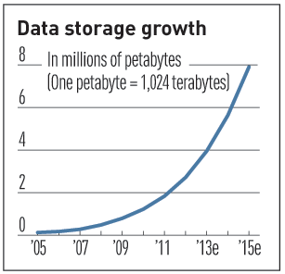

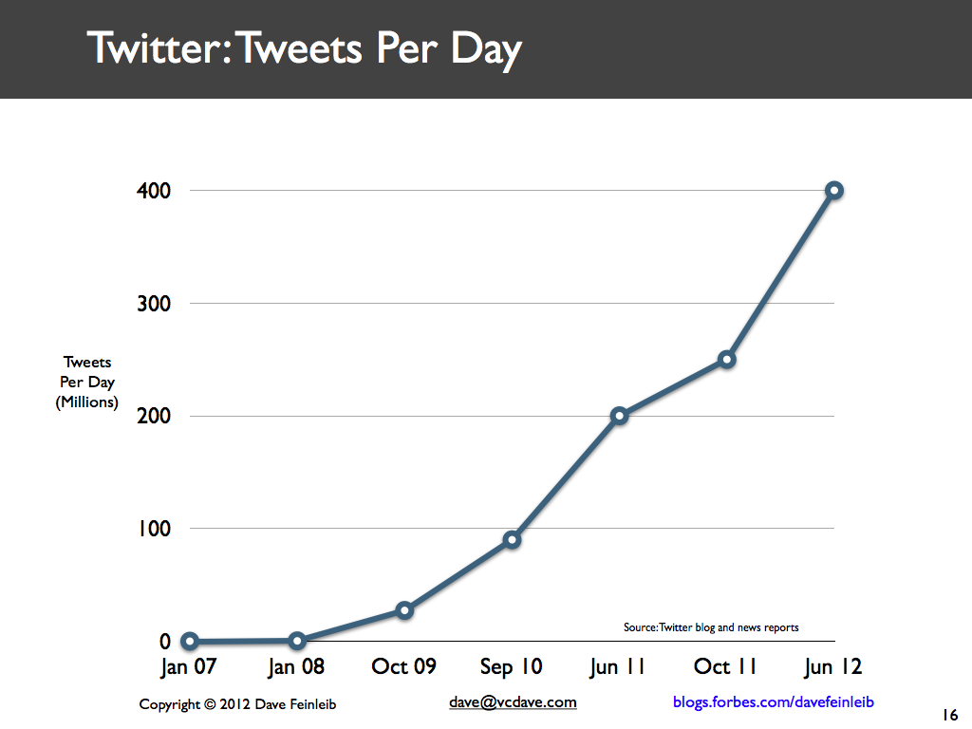
Volume (Scale)
Data Volume
44x increase from 2009 2020
From 0.8 zettabytes to 35zb
Data volume is increasing exponentially
Exponential increase in collected/generated data

Slide 12
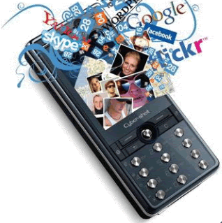
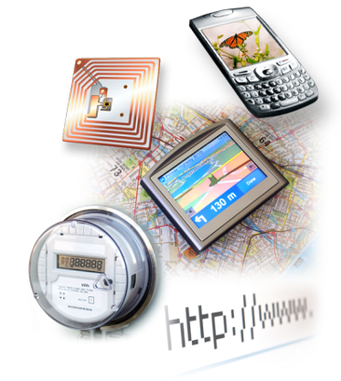

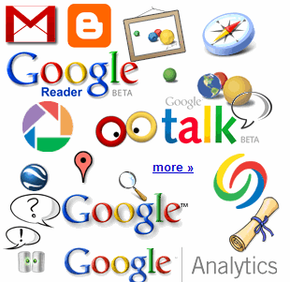

4.6 billion camera phones world wide
30 billion RFID tags today (1.3B in 2005)
12+ TBs of tweet data every day
100s of millions of GPS enabled devices sold annually
? TBs of data every day
25+ TBs of log data every day
2+ billion people on the Web by end 2011
76 million smart meters in 2009… 200M by 2014

Slide 13
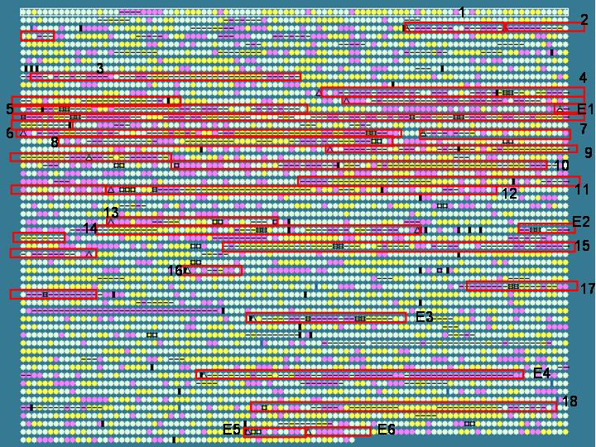
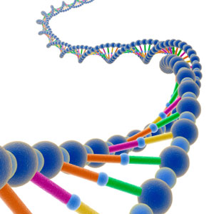
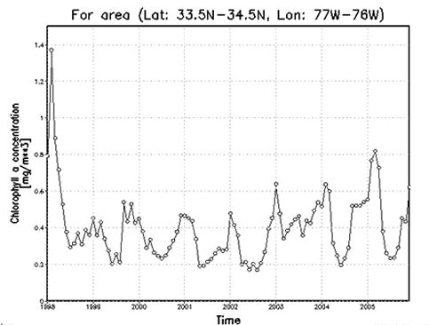

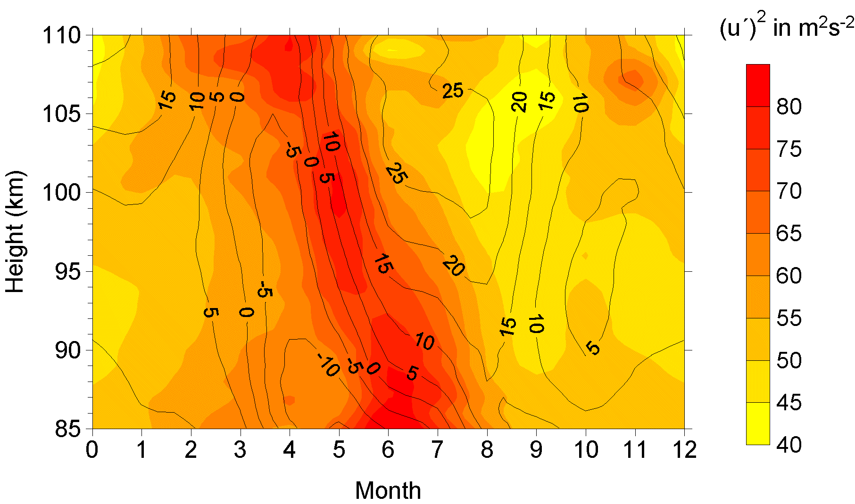
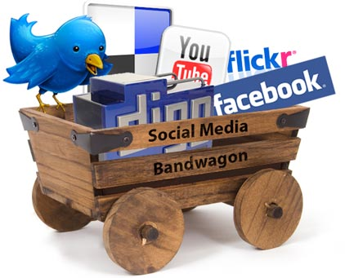
Variety (Complexity)
Relational Data (Tables/Transaction/Legacy Data)
Text Data (Web)
Semi-structured Data (XML)
Graph Data
Social Network, Semantic Web (RDF), …
Streaming Data
You can only scan the data once
A single application can be generating/collecting many types of data
Big Public Data (online, weather, finance, etc)
To extract knowledge➔ all these types of data need to linked together

Slide 14

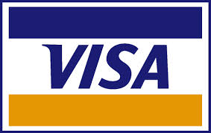















A Single View to the Customer
Social Media
Banking
Finance
Gaming
Our
Known
History
Customer
Entertain
Purchase

Slide 15

Velocity (Speed)
Data is begin generated fast and need to be processed fast
Online Data Analytics
Late decisions ➔ missing opportunities
Examples
E-Promotions: Based on your current location, your purchase history, what you like ➔ send promotions right now for store next to you
Healthcare monitoring: sensors monitoring your activities and body ➔ any abnormal measurements require immediate reaction

Slide 16
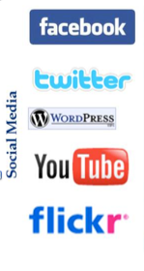
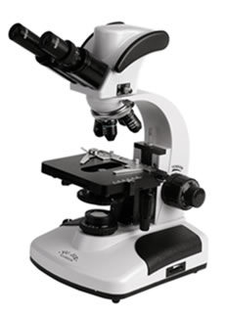

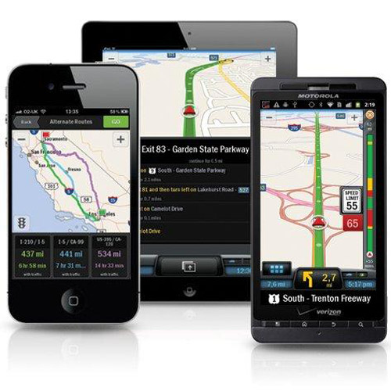
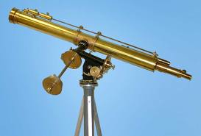
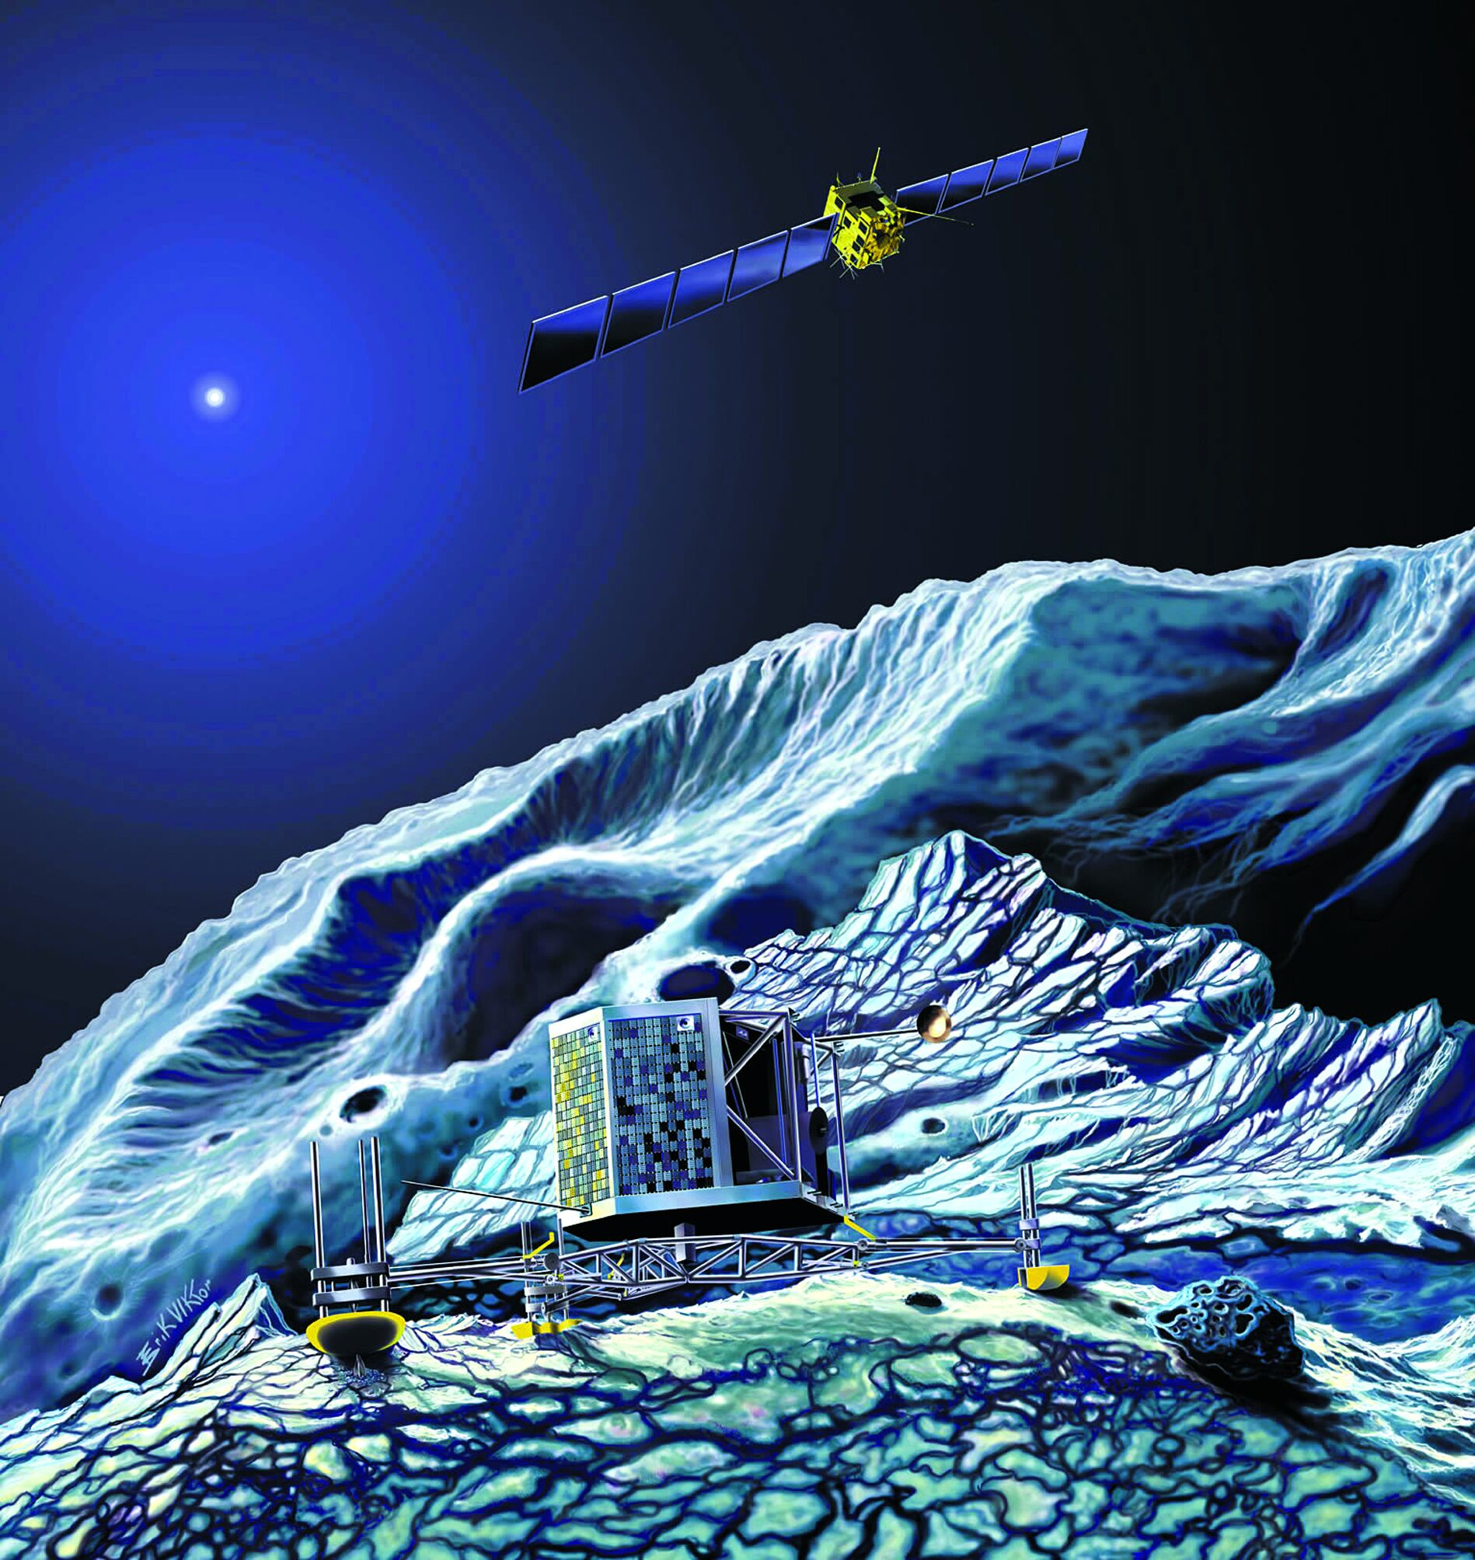
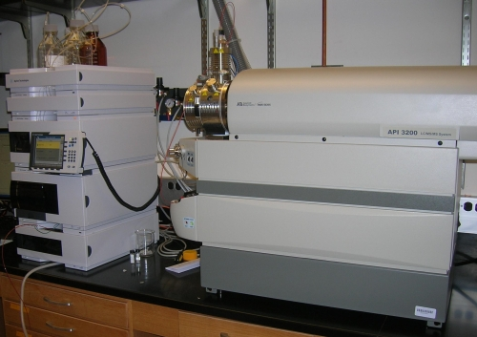
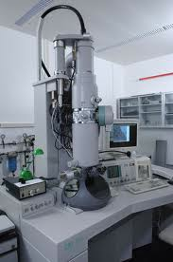
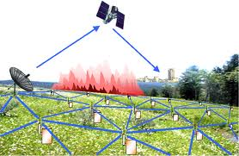
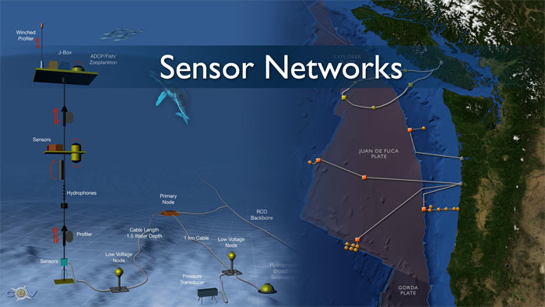
Real-time/Fast Data
Mobile devices
(tracking all objects all the time)
Social media and networks
(all of us are generating data)
Scientific instruments
(collecting all sorts of data)
Sensor technology and networks
(measuring all kinds of data)
The progress and innovation is no longer hindered by the ability to collect data
But, by the ability to manage, analyze, summarize, visualize, and discover knowledge from the collected data in a timely manner and in a scalable fashion

Slide 17
Real-Time Analytics/Decision Requirement
Product
Recommendations
that are Relevant
& Compelling
Learning why Customers
Switch to competitors
and their offers; in
time to Counter
Influence
Behavior
Customer
Friend Invitations
to join a
Game or Activity
that expands
business
Improving the
Marketing
Effectiveness of a
Promotion while it
is still in Play
Preventing Fraud
as it is Occurring
& preventing more
proactively

Slide 18
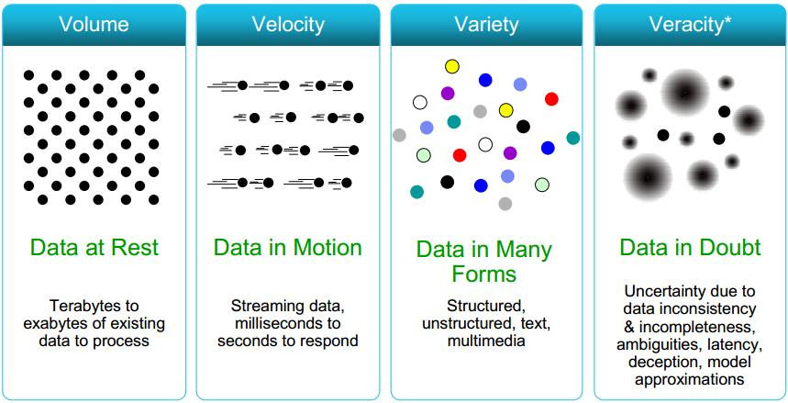
Some Make it 4V’s

Slide 19
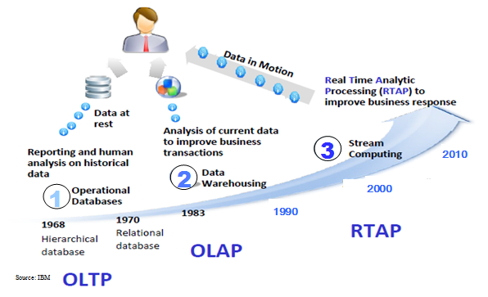
Connecting Big Data
OLTP: Online Transaction Processing (DBMSs)
OLAP: Online Analytical Processing (Data Warehousing)
RTAP: Real-Time Analytics Processing (Big Data Architecture & technology)

Slide 20
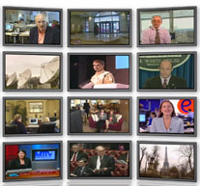

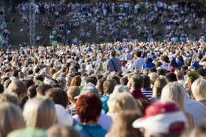

The Model Has Changed…
The Model of Generating/Consuming Data has Changed
Old Model: Few companies are generating data, all others are consuming data
New Model: all of us are generating data, and all of us are consuming data

Slide 21
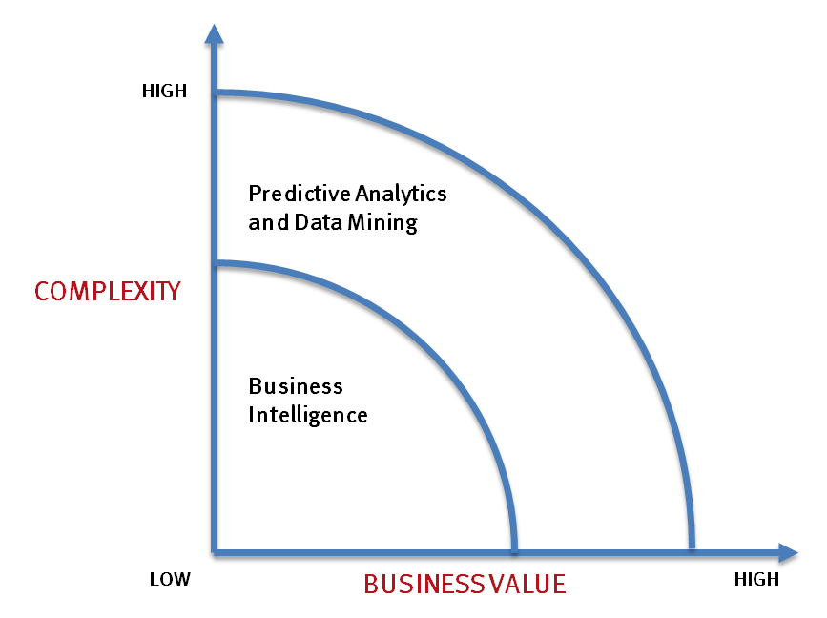
What’s driving Big Data
- Optimizations and predictive analytics
- Complex statistical analysis
- All types of data, and many sources
- Very large datasets
- More of a real-time
- Ad-hoc querying and reporting
- Data mining techniques
- Structured data, typical sources
- Small to mid-size datasets

Slide 22
The Evolution of Business Intelligence
Interactive Business Intelligence &
In-memory RDBMS
QliqView, Tableau, HANA
Big Data:
Real Time &
Single View
Graph Databases
Speed
Scale
BI Reporting
OLAP &
Dataware house
Business Objects, SAS, Informatica, Cognos other SQL Reporting Tools
Big Data:
Batch Processing &
Distributed Data Store
Hadoop/Spark; HBase/Cassandra
Scale
Speed
1990’s
2000’s
2010’s

Slide 23
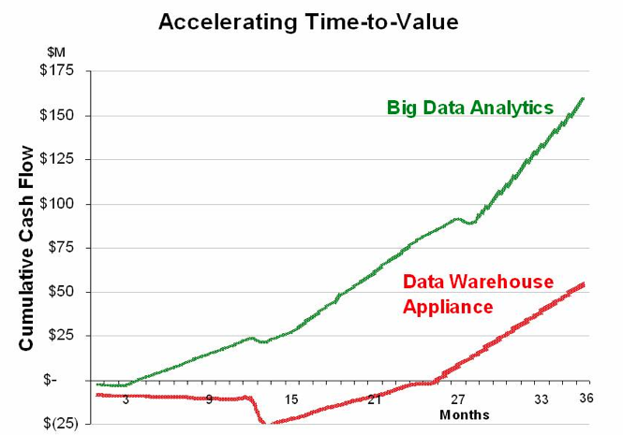
Big Data Analytics
Big data is more real-time in nature than traditional DW applications
Traditional DW architectures (e.g. Exadata(Oracle Exadata Database Machine), Teradata) are not well-suited for big data apps
Shared nothing, massively parallel processing, scale out architectures are well-suited for big data apps

Slide 24
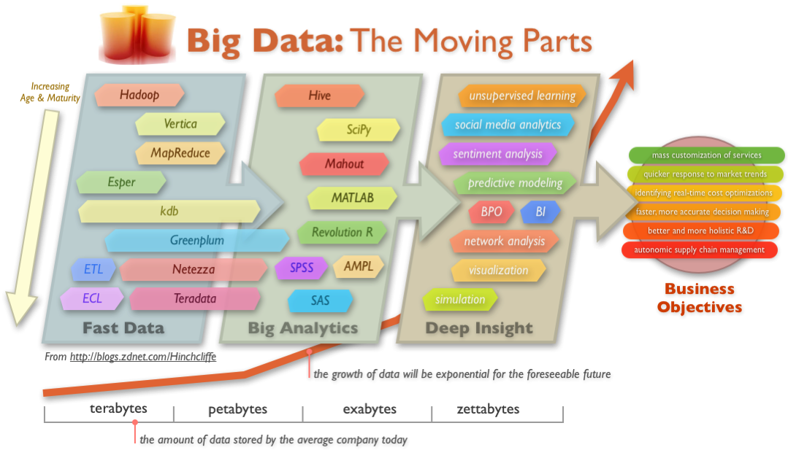
Big Data Technology

